Slide 1


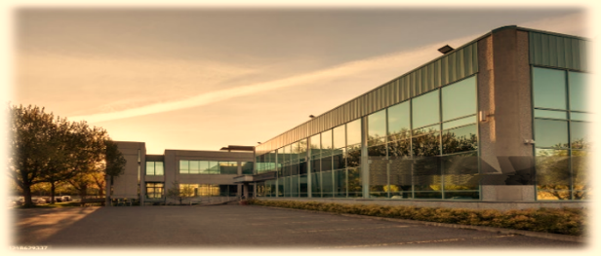
COMPANY PROFILE
MORAL FASHIONS LTD EXCLUSIVE KNITWEAR MANUFACTURER
FACTORY
39, Kuturia, Dewan Market, Ashulia, Dhaka-1344, Bangladesh
Web:www.moralfashion.com
Email:info@moralfashion.com
Mobile:-01940405014

Slide 2
CONTENT
MESSAGE FROM MANAGING DIRECTOR
ABOUT THE COMPANY
GENERAL INFORMATION
IMPORTANT CONTACTS
COMPANY MISSION & VISSION
LOCATION MAP
PRODUCT GALLERY
DESIGN & DEVELOPMENT
QUALITY CONTROL
CUTTING DEPARTMENT
SEWING DEPARTMENT
FINISHING DEPARTMENT
WORK PLACE ENVIRONMENT
COMPLIANCE & POLICY
OUR FOCUS
MEMBERSHIP CERTIFICATE
MECHINARYS
OUR HONORABLE CLIENT
CUSTOMER LIST
WHY CHOICE US

Slide 3
MESSAGE FROM
MANAGING DIRECTOR
Moral Fashion Ltd was born with a dream of becoming a leader in the apparel manufacturing sector, and we are working wholeheartedly with our dedicated and expert team to fulfill this vision.
Welcome to Moral Fashion Ltd, a modern setup for basic and fancy knitwear located at 39, Kuturia, Dewan Market, Ashulia, Dhaka-1344, Bangladesh. We offer high-quality products at very competitive prices with guaranteed on-time delivery.
We have an experienced and expert production team, a fast-sampling service, and a strict quality control system. Our factory is audited and certified by BSCI, SEDEX, OEKO-TEX, GOTS, and OCS, which ensures strong social compliance and continuously improves working conditions.
We manufacture and export all kinds of knitted items, including baby wear, men’s wear, and women’s tops and bottoms.

Slide 4
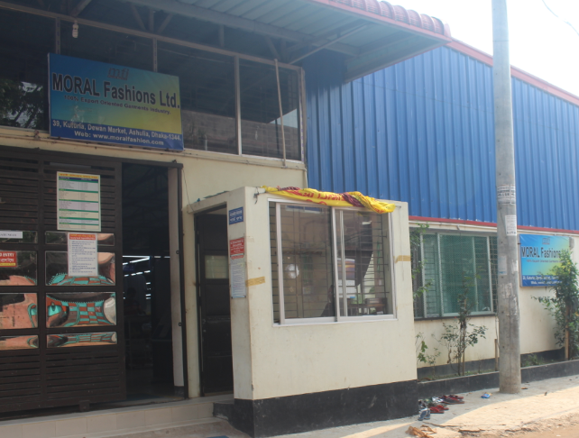
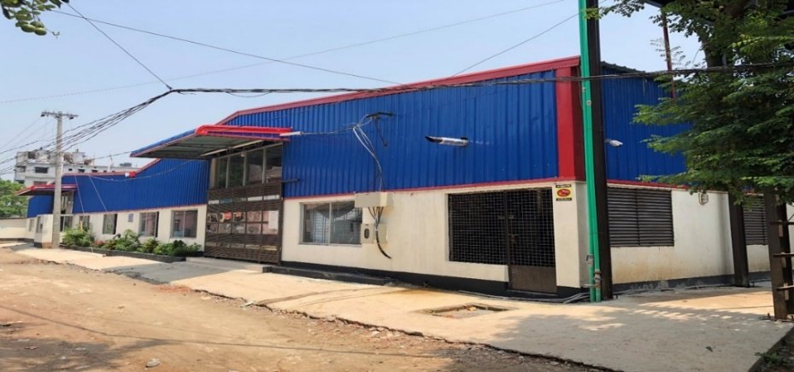
ABOUT THE COMPANY
WELCOME TO MORAL FASHIONS LTD
Moral Fashions Ltd. is a leading manufacturer and exporter of knit garments in Bangladesh, proudly serving international markets since October 2011. With a well-organized and experienced professional team, we specialize in producing high-quality knitted ready-made garments for clients across Europe, the USA, and Canada.
We are committed to maintaining superior product quality while strictly adhering to lead times. Our strong merchandising team ensures highly competitive pricing across a wide range of knitwear products, meeting diverse buyer requirements.
Our production facilities are strategically divided into separate knitting and sewing units located in two buildings, enabling us to efficiently handle large-scale orders according to precise buyer specifications. This integrated setup allows us to maintain strict quality control and deliver products with an exceptional finish.
Located at 39, Kuturia, Dewan Market, Ashulia, Dhaka-1344, Bangladesh, our factory spans approximately 50,000 square feet, including our knitting unit. Our product range includes T-shirts, polo shirts, tank tops, sweatshirts, hoodies, jackets, pants, and leggings for men, women, and children, available in a wide variety of fabrics and colors.
At Moral Fashions Ltd., we place great importance on employee welfare and workplace safety. We continuously invest in our workforce to ensure a safe and supportive working environment. Our facility is equipped with modern firefighting systems, fire alarms, safe drinking water, hygienic dining areas, first-aid services, and a day-care center for employees’ children.
Our modern production approach, combined with the use of advanced international machinery, enables us to consistently meet the evolving fashion demands of global markets. We are dedicated to delivering export-quality garments that meet international standards.
For inquiries, please share your product details with us. We assure you of competitive pricing, timely delivery, and uncompromising quality.

Slide 5
GENERAL INFORMATION
Company Name: | Moral Fashions Ltd
Type of Business: | Manufacturer and Exporter of readymade garments.
Legal Status: | Private Limited Company
Bank: | Account Name: Moral Fashions Ltd. Account No.: 0051020005204 One Bank LTD SOMSER PLAZA, BOLI BHADRA BAZAR, GANAKBARI, SAVAR, DHAKA Ph: 88-02-7789653-4 Swift Code: ONEBBDDH005
Factory Space: | 30000 sq. ft. (Initial Stage)
Sewing Capacity | 4.5 to 5.00 Million Pcs Per Year
Knitting Capacity: | 06 Ton / day

Slide 6
IMPORTANT CONTRACT
Managing Director: | Nasrin Akter
Cell : | +8801712-964135
E-mail ID: | nasrin@moralfashion.com
Director: | Md.Showkat Ali
Cell : | +8801711-285129
E-mail ID: | showkat@moralfashion.com

Slide 7
OUR MISSION
Deliver superior-quality products at competitive prices with the shortest possible lead times.
Foster innovation while ensuring sustainability across all operations.
Cultivate strong, long-term partnerships with clients and stakeholders.
Drive customer satisfaction through consistent service excellence and sustainable profitability.
OUR VISSION
Moral Fashions Ltd. aspires to become a highly competent and sustainable garment manufacturing organization, driven by strong governance and accountability to all stakeholders. The company integrates state-of-the-art technology with proven process techniques and creative design to deliver high-quality, trend-driven garments that meet the ever-evolving demands of the global market.

Slide 8
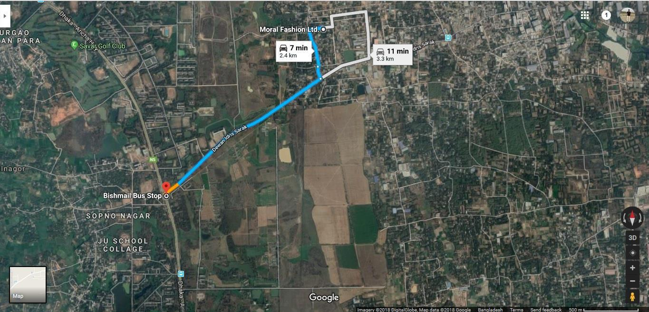
MORAL FASHIONS LTD EXCLUSIVE KNITWEAR MANUFACTURER
FACTORY LOCATION MAP

Slide 9
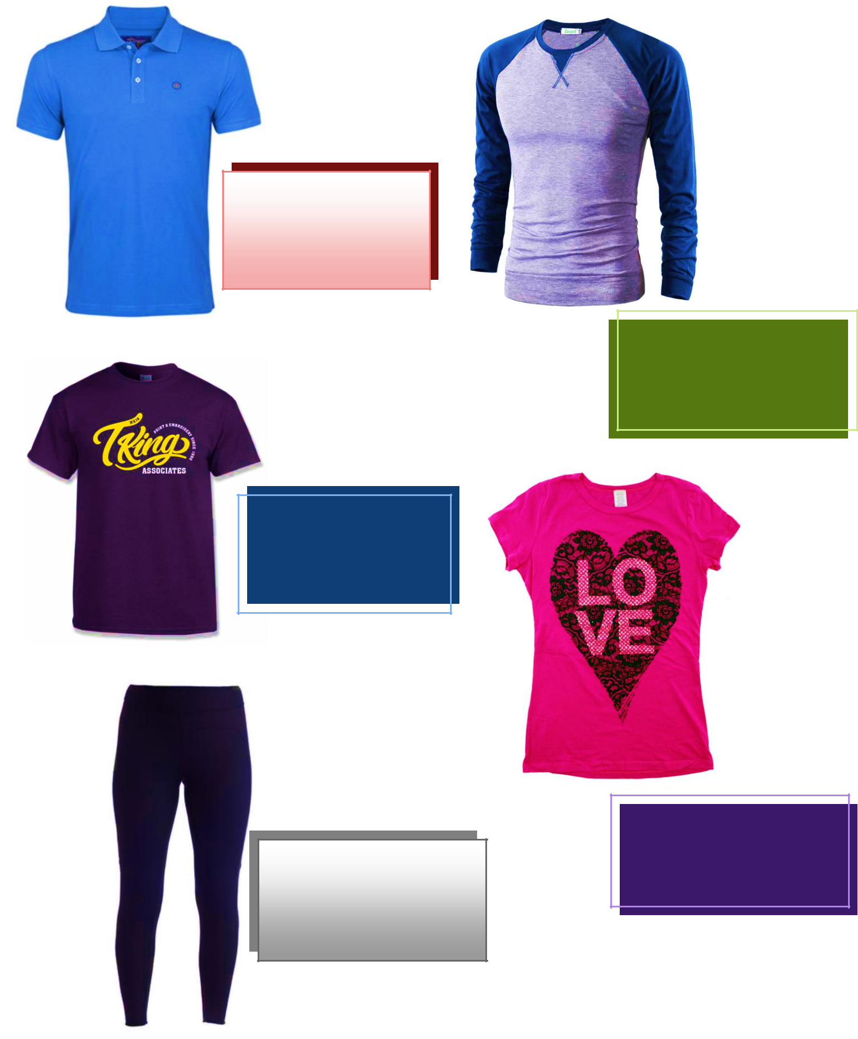
Moral Fashions Ltd. offers a diverse range of high-quality knit garments, including basic and fancy polo shirts, sweatshirts, and T-shirts. Our product line also extends to a wide variety of men’s, women’s, and children’s knitwear, designed to meet the latest fashion trends and customer requirements.
We specialize in different fabric types such as single jersey, pique, interlock, fleece, and rib, with options for both basic and value-added styles. Our capabilities include various embellishments like printing (screen, pigment, discharge), embroidery, appliqué, and washing effects.
We are committed to delivering products with superior quality, precise fitting, and excellent finishing, ensuring compliance with international standards and buyer specifications.
Per day capacity
PRODUCT GALLERY
Polo Shirt
Style: Regular/Fancy
Production Capacity: 10,000 Per day
Reglan Sleeve T-Shirt
Style: Regula
Production Capacity:
15,000 per day
Printed T-Shirt
Style: Basic/Fancy
Production Capacity: 20,000 Per day
Ladies Wear
Style: Basic/Fancy
Production Capacity:
20,000 per day
Ladies Leggings
Style: Basic/Fancy
Production Capacity:
20,000 per day

Slide 10
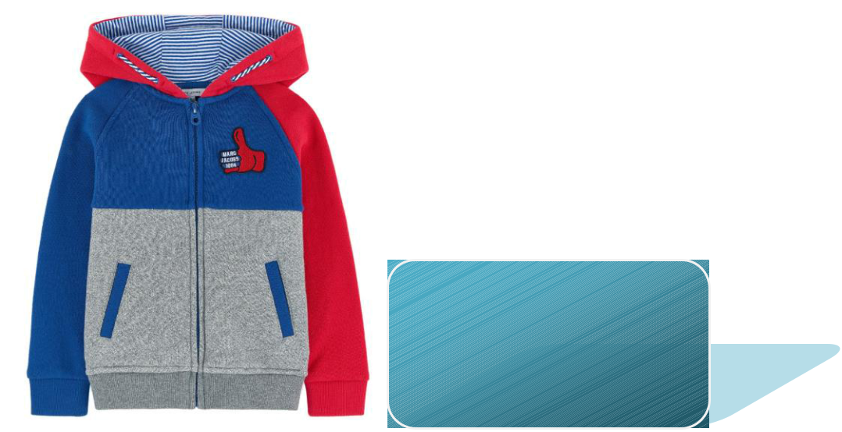
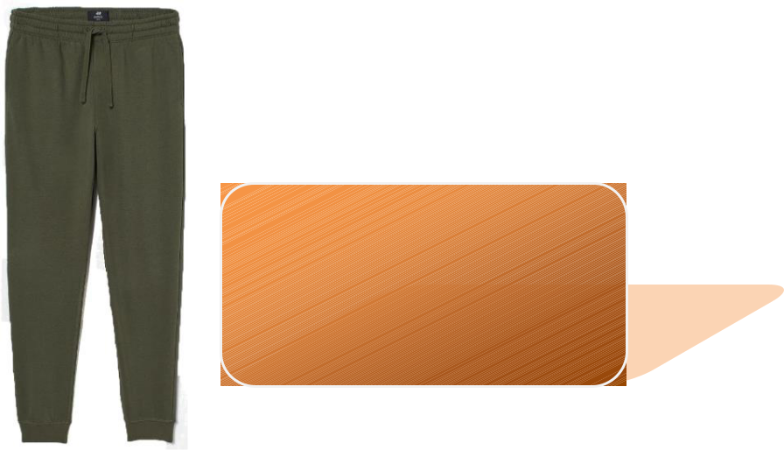
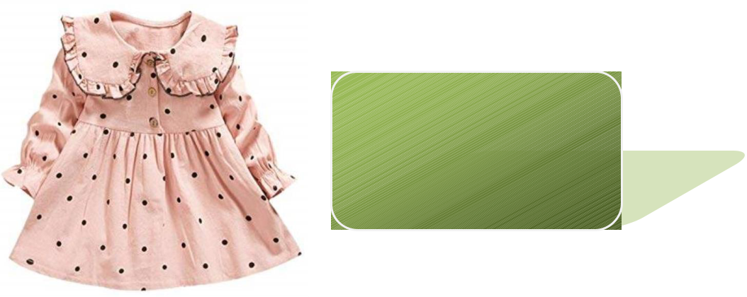
Hooded Sweatshirt
Style: Fancy
Production Capacity:
12,000 per day
Sweatpants
Style: Basic/Fancy
Production Capacity:
14,000 per day
Infant Dress
Style: Fancy
Production Capacity:
12,000 pcs per day

Slide 11
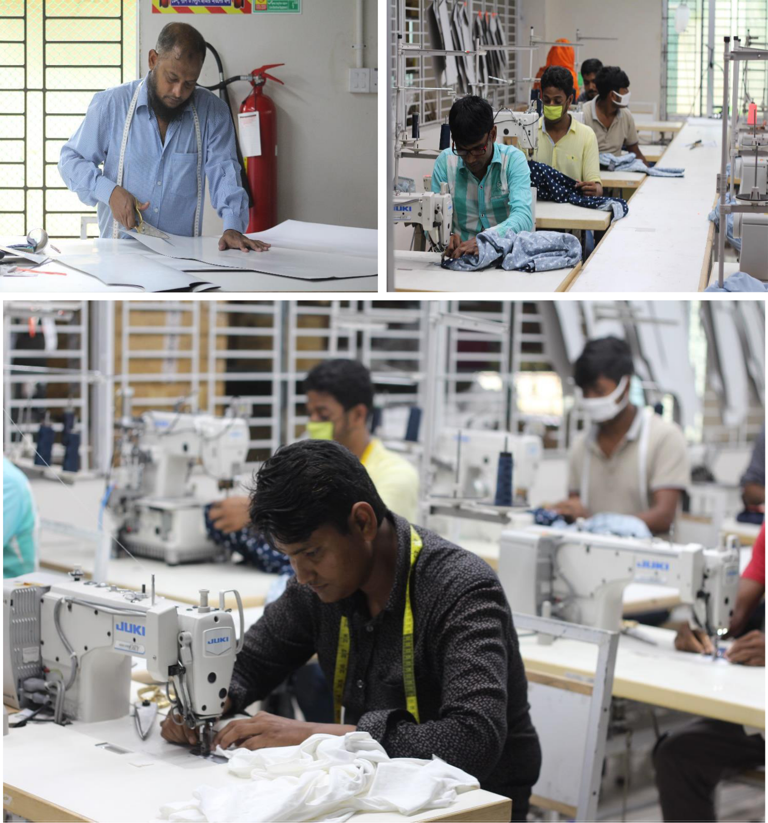
DESIGN AND DEVELOPMENT
Moral Fashions Ltd. has established a dedicated Product Design & Development department, staffed by experienced professionals capable of delivering precise samples tailored to clients’ requirements. By working closely with clients—from initial sketches or original samples through to the development of a full range of counter samples—the team ensures accuracy, quality, and added value at every stage

Slide 12
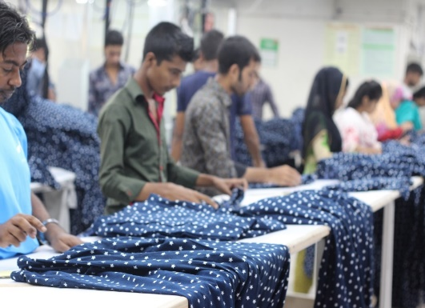
QUALITY CONTROL & ASSURANCE
Moral Fashions Ltd maintains a comprehensive Quality Control System encompassing strict inspections of raw materials, in-process operations, and finished products. This structured control mechanism ensures that every stage of production meets defined quality standards.
The company is also distinguished by its industry-leading low rework and repair rates, reflecting strong process control and skilled execution. As a result, Moral Fashions Ltd is able to deliver high-quality garments within the shortest possible lead time, ensuring both efficiency and customer satisfaction.

Slide 13
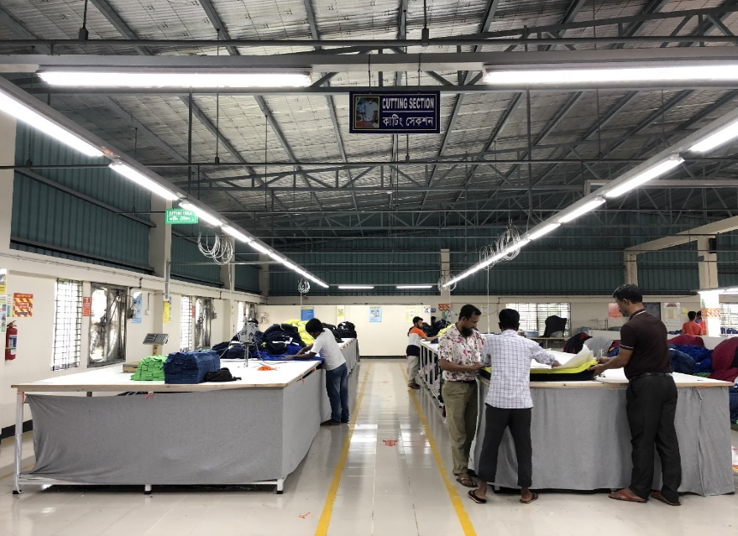
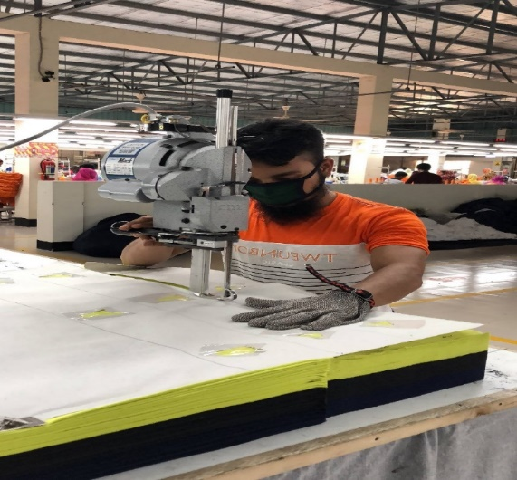
CUTTING DEPARTMENT
The Cutting Section is well-equipped with advanced, high-precision cutting machines to ensure accurate and efficient fabric cutting. All fabrics are inspected on a roll-to-roll basis prior to trial and bulk cutting. GSM is tested using a digital GSM scale before the cutting process begins to maintain consistency and quality.
Fabric shade is carefully evaluated under both natural daylight and controlled light box conditions to ensure color accuracy. Any batch-to-batch shade variations are strictly monitored and promptly resolved. Fabric relaxation is considered essential before cutting, and high lay is avoided to maintain precise measurements and cutting accuracy.
We are also in the process of implementing CAD-guided marker planning and an automated cutting system to further enhance efficiency and precision.

Slide 14
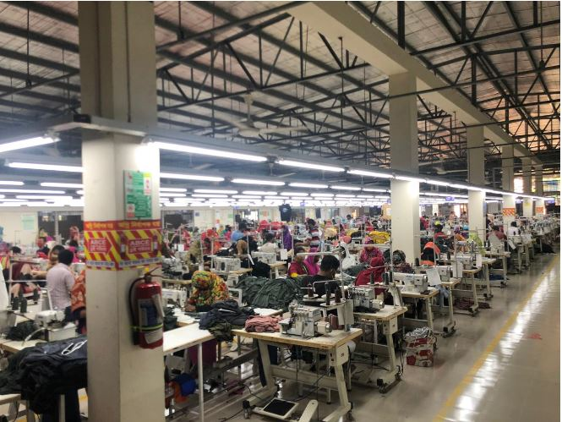
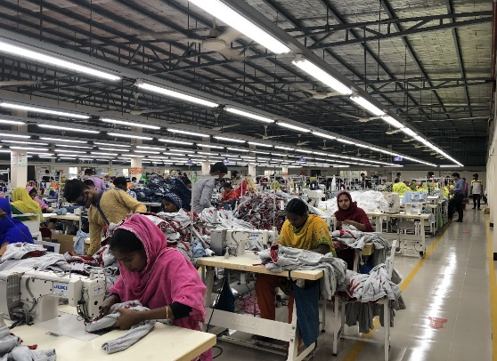
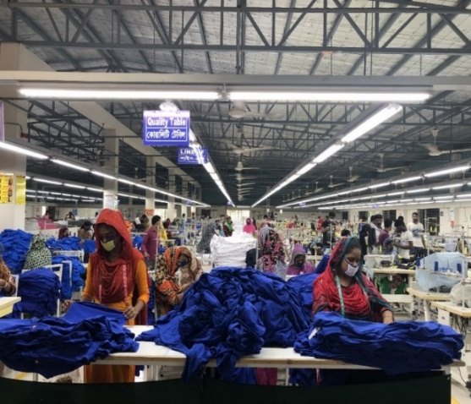
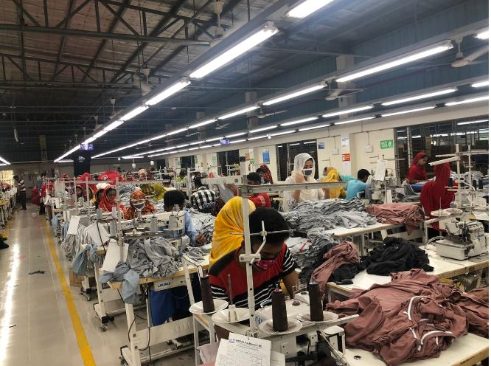
SEWING DEPARTMENT
Our sewing lines are equipped with state-of-the-art, brand-new JUKI machines imported from Japan, ensuring high efficiency and precision in production. The production floor is maintained with strict cleanliness standards, supported by a well-designed ventilation system and an
adequate number of ceiling and exhaust fans to ensure a hygienic working environment.
Lighting levels are regularly monitored using a lux meter to maintain optimal visibility. Electrical installations are safely managed through a busbar system. A centralized audio system is in place for effective communication and announcements across the floor.
For safety, adequate fire extinguishers are strategically placed at standard intervals to handle any emergency situation. Additionally, a single long-table garment passing system is implemented to enhance workflow efficiency and ensure faster production.

Slide 15
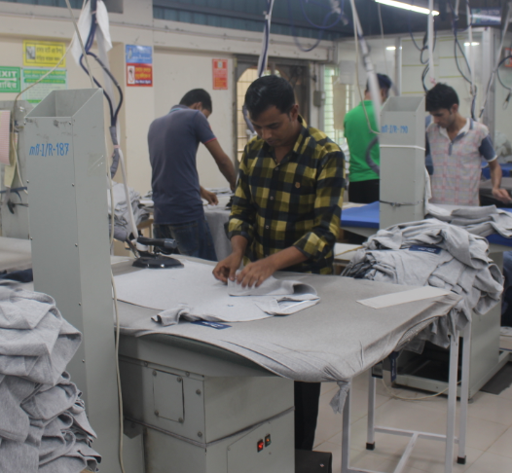
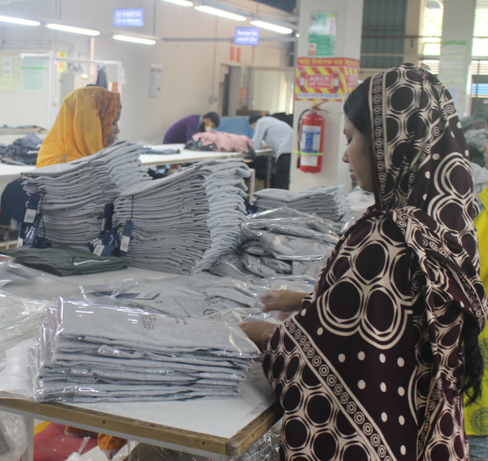
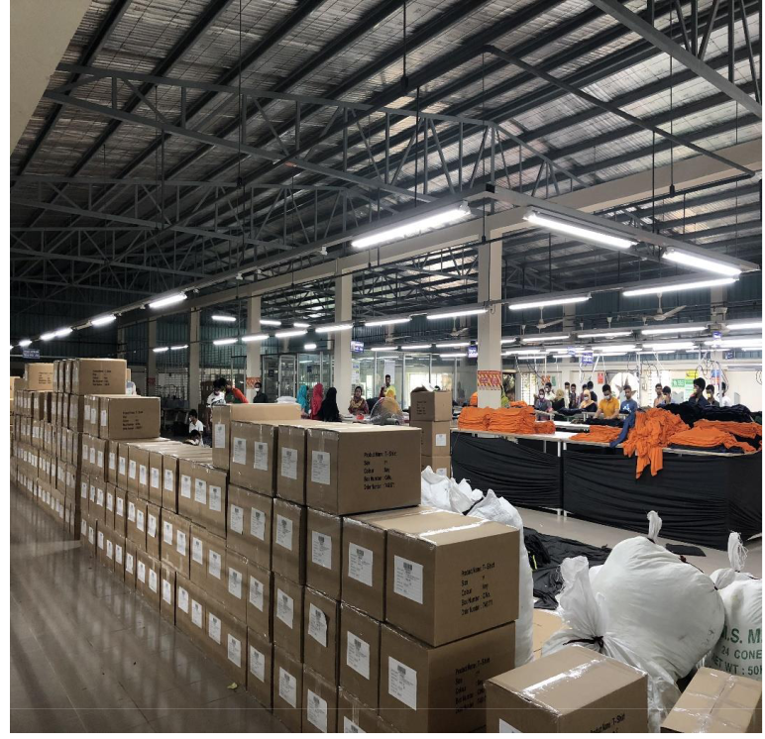
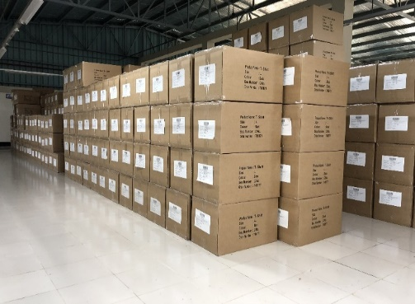
FINISHING DEPARTMENT
The Finishing Section is located in a separate area of the building and is properly partitioned from other production sections to maintain a clean, dry, and controlled environment. An adequate number of fire safety equipment has been installed at regular intervals to ensure workplace safety.
Since the section is situated on the same floor as the transport area, finished cartons can be transferred quickly and efficiently for dispatch. After packing, cartons are moved to the finished goods warehouse, which is also located on the same floor, just adjacent to the transport parking area, ensuring smooth handling and faster delivery operations.

Slide 16
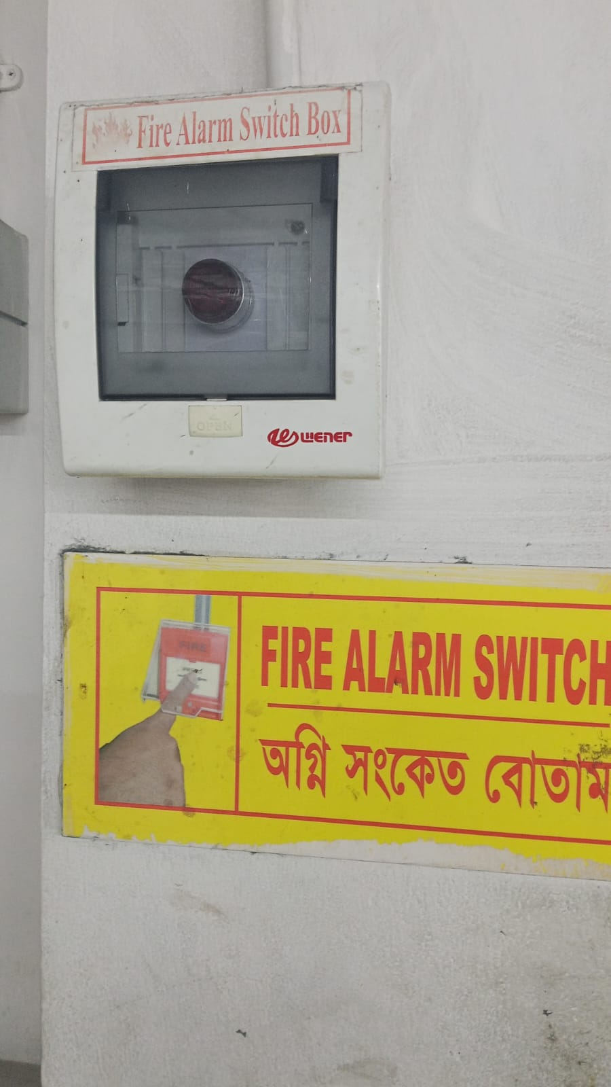
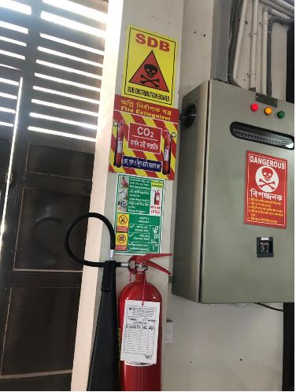
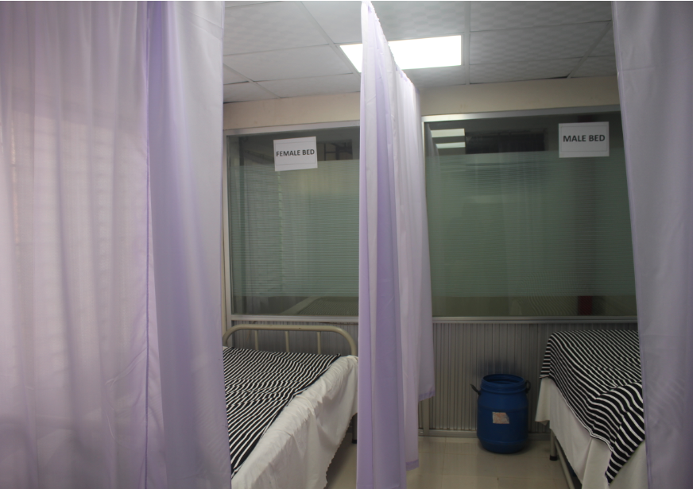

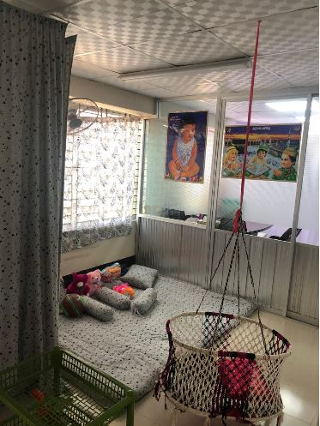
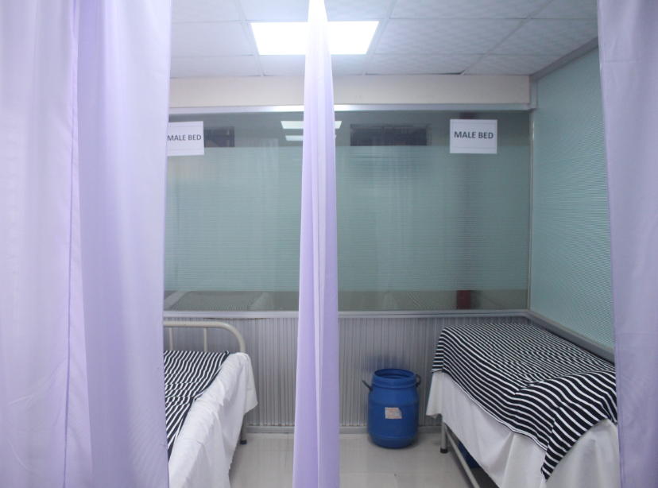
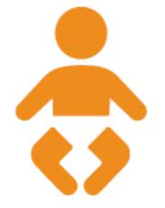

WORK PLACE & ENVIRONMENT
As a responsible apparel manufacturer, Moral Fashions Ltd. provides its employees with a work environment that goes well beyond legally required standards. The company has installed and continuously upgraded lighting, ventilation, and ergonomic facilities across its factories using modern technologies such as bus-bar electrical systems, overhead mirror reflectors for improved lighting efficiency, and forced duct ventilation systems.
In addition to ensuring workplace safety, Moral Fashions Ltd. fosters a congenial and supportive environment where managerial staff and workers collaborate with mutual respect and cooperation. The company strongly believes in “worker safety first” and places special emphasis on the safety, wellbeing, and dignity of women workers.
FIRE PROTECTION
BABY CARE
MEDICAL CARE

Slide 17
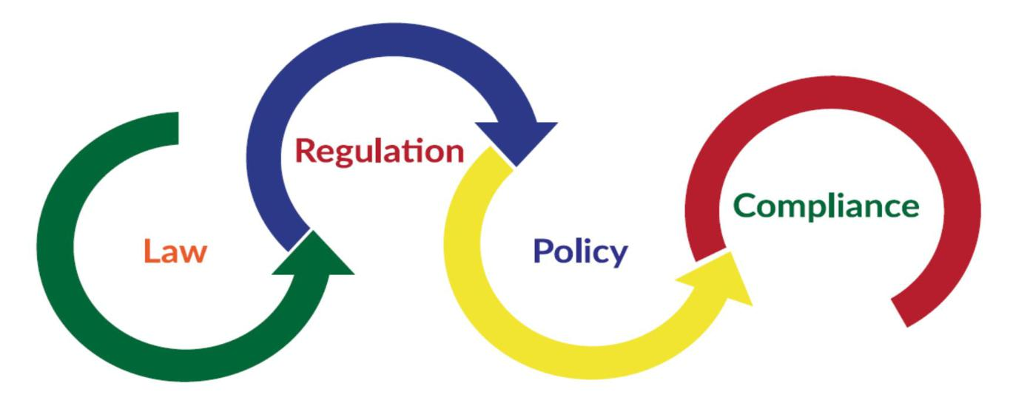
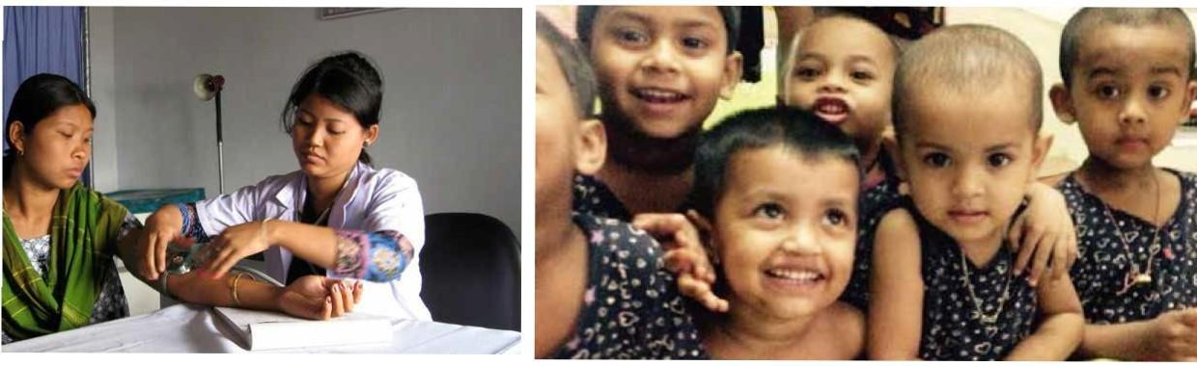


COMPLIANCE & POLICY
SKILL DEVELOPMENT TRAININGS
TRANSPORTATION

Slide 18
BEING COMPLAINT IS OUR PRIMARY FOCUS
WORKPLACE ENVIRONMENT:
Moral Fashions Ltd. is committed to providing a healthy and safe working environment that exceeds legal compliance requirements. The factory is equipped with modern infrastructure, including advanced lighting systems, efficient ventilation, and improved ergonomic arrangements to ensure worker comfort and productivity. The use of updated technologies, such as busbar electrical systems, enhances operational safety and efficiency.
Clearly marked emergency routes and exits, along with installed smoke and fire detection systems, ensure preparedness for any emergency situation. The production floor is designed with well-organized layouts to maintain a safe and efficient workflow. In line with buyer compliance standards, safety instructions and warning signage are prominently displayed throughout the facility in the local language (Bengali) for better understanding and accessibility.
To further minimize workplace risks, the company enforces the use of personal protective equipment such as metal gloves during fabric cutting and needle guards during sewing operations. These measures significantly reduce the likelihood of work-related accidents.
In addition to physical safety, Moral Fashions Ltd. fosters a positive and inclusive work environment. A culture of mutual respect and cooperation exists between management and workers, contributing to a supportive and harmonious workplace for all.
WORKERS’ WELFARE:
Moral Fashion Ltd. is committed to the well-being of its employees by providing comprehensive welfare facilities, including a medical center, day-care center, and canteen. The medical unit is staffed with a full-time doctor and nurse, offering consultation and necessary medication to workers. The company ensures adequate and well-maintained arrangements for canteen services, safe drinking water, and hygienic sanitation facilities. In times of emergency, Moral Fashion Ltd. extends financial assistance to its employees. Additionally, the company organizes recreational programs from time to time for workers and their families, promoting a healthy work-life balance. All workers and staff are covered under insurance for added security and support.
We are fully committed to compliance and ethical standards. Our company holds internationally recognized certifications, including BSCI and Sedex (4-Pillar). In addition, we are certified in GOTS, OCS, and OEKO-TEX Standard, ensuring our products meet global requirements for sustainability, organic content, and safety.

Slide 19



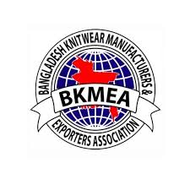
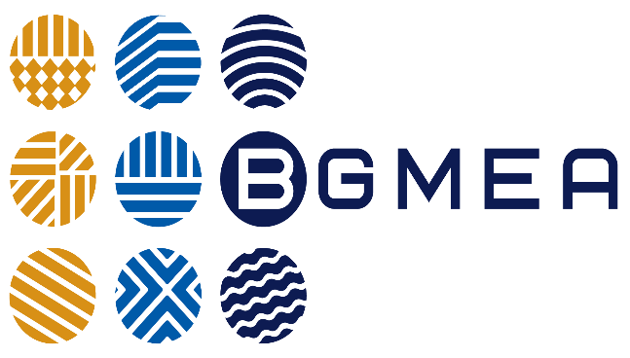
MEMBERSHIP CERTIFICATIONS

Slide 20
MACHINARIES
SI | MACHINE TYPES | NO OF UNITS | BRAND | MODEL | ORIGIN
1 | LOCK STITCH | 110 | JUKI | DDL 900A | JAPAN
2 | OVER LOCK | 85 | JUKI | MO 6814D | JAPAN
3 | FLAT LOCK C11 | 35 | JUKI | MF7523D | JAPAN
4 | FLAT LOCK U11 | 16 | JUKI | MF7523D | JAPAN
5 | FLAT LOCK SYLINDER BED U11 | 40 | JUKI | MF7923 U11 | JAPAN
6 | CYLINDER BED REW-S-CUTTER | 26 | JUKI | MF7923 H23 | JAPAN
7 | BARTACKING | 6 | JUKI | LK 900B | JAPAN
8 | KANSAI DFB | 12 | JUKI | DFB 1411 P | JAPAN
9 | KANSAI LOOP | 15 | JUKI | DLR 1502 L | JAPAN
10 | SMALL SYLINDER BED | 12 | JUKI | MF7223DU10 | JAPAN
11 | BUTTON STITCH | 14 | JUKI | LK 1903B | JAPAN
12 | SNAP BUTTON MACHINE | 8 | JUKI | UZ.7EA | JAPAN
13 | RIB CUTTER (PIPING STRIPE) | 6 | JUKI | LU.933A | JAPAN
14 | BUTTON HOLE | 8 | JUKI | LBH1790A | JAPAN
15 | FIT OF THE ARM | 6 | JUKI | MS1190MF | JAPAN
16 | CUTTING | 6 |  | 8” & 10”
17 | IRON MACHINE | 16 |  | ASS1450
18 | IRON TABLE | 16 |  | COOL SET
19 | GENERATOR | 1 | CAT | 200 KVA | USA
20 | BOILER | 1 | ALIF BOILER COM | 200 KG

Slide 21
KNITTING MACHINERIES
SL | DIA | GAUGE | NO OF FEEDER | TYPES OF MACHINE | BRAND | ORIGIN | QUANTITY | REMARKS
01 | 28” TUBE | 24 G | 84 F | S/JERSEY | JINHAR | TAIWAN | 1 | 100% LYCRA ATTACHED
02 | 30” FLEECE | 20G+24G | 90 F | FLEECE+S/JERSEY | JINHAR | TAIWAN | 1 | 100% LYCRA ATTACHED
03 | 32” FLEECE | 20G+24G | 96 F | FLEECE+S/JERSEY | JINHAR | TAIWAN | 1 | 100% LYCRA ATTACHED
04 | 34” FLEECE | 20G+24G | 102 F | FLEECE+S/JERSEY | JINHAR | TAIWAN | 1 | 100% LYCRA ATTACHED
05 | 38” TUBE | 24 G | 114 F | S/JERSEY | JINHAR | TAIWAN | 1 | 100% LYCRA ATTACHED
06 | 30” OPEN WIDTH | 24 G | 90 F | JS/JERSEY | JINHAR | TAIWAN CHINA | 2 | 100% LYCRA ATTACHED
07 | 32” OPEN WIDTH | 24 G | 96 F | SINGLE JERSEY | JINHAR | TAIWAN | 2 | 100% LYCRA ATTACHED
08 | 34” OPEN WIDTH | 24 G | 102 F | S/JERSEY | JINHAR HENGYL QM | TAIWAN CHINA | 3 | 100% LYCRA ATTACHED
09 | 36” OPEN WIDTH | 24 G | 108 F | S/JERSEY | JINHAR HENGYL QM | TAINWAN CHINA | 3 | 100% LYCRA ATTACHED
10 | 38” OPEN WIDTH | 24 G | 114 F | S/JERSEY | JINHAR HENGYL QM | TAIWAN CHINA | 3 | 100% LYCRA ATTACHED
11 | 40” OPEN WIDTH | 24 G | 120 F | S/JERSEY | JINHAR QM | TAIWAN | 2 | 100% LYCRA ATTACHED
12 | 32” | 18G+24G | 64 F | RIB+ INTER LOCK | JINHAR | TAIWAN | 1 | 100% LYCRA ATTACHED
13 | 34” | 18G+24G | 68 F | RIB + INTER LOCK | JINHAR | TAIWAN | 1 | 100% LYCRA ATTACHED
14 | 36” | 18+24G | 72 F | RIB+ INTER LOCK | JIINHAR | TAIWAN | 1 | 100% LYCRA ATTACHED

Slide 22
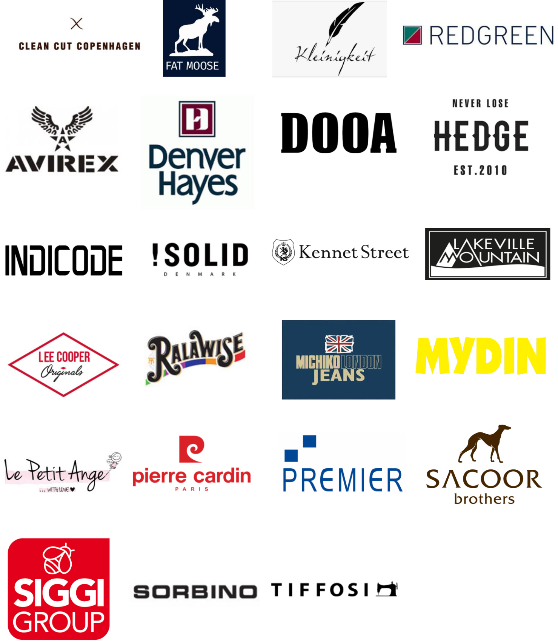
OUR HONORABLE CLIENT

Slide 23
CUSTOMER LIST
BUYER NAME | BRAND NAME | COUNTRY
BASIC FASHION | OKEY ABSOLUT | FINLAND
STYLE TEX | HFG GOR FACTORY | HOLLAND SPAIN
MARTY TEX | DOOA SORBINO HAMAKI-HO GAZZARINI STUDIO 53 | ITALY
PRO-SOURCING International Ltd | CLEAN CUT FAT MOOSE SIGNAL MBO Startex | DENMARK
TOKO SUJI | HUSH PAPPY SHIMAMURA MICHIKO LONDON BLUEMATE WOODS KANSAI | JAPAN
SRG APPERALS PLC | STOCK STUDIO KENSINGTON CHRISTMAS TOKYO LOUNDRY AMARA REYA TISSIAI NINES | UNITED KINGDOM
ARP TRADING | LEE COOPER FRENCH CONNECTION PREMIER CLOUSER LONDON WESTON JON PORCHEE | UK UK UK USA USA GERMANY

Slide 24
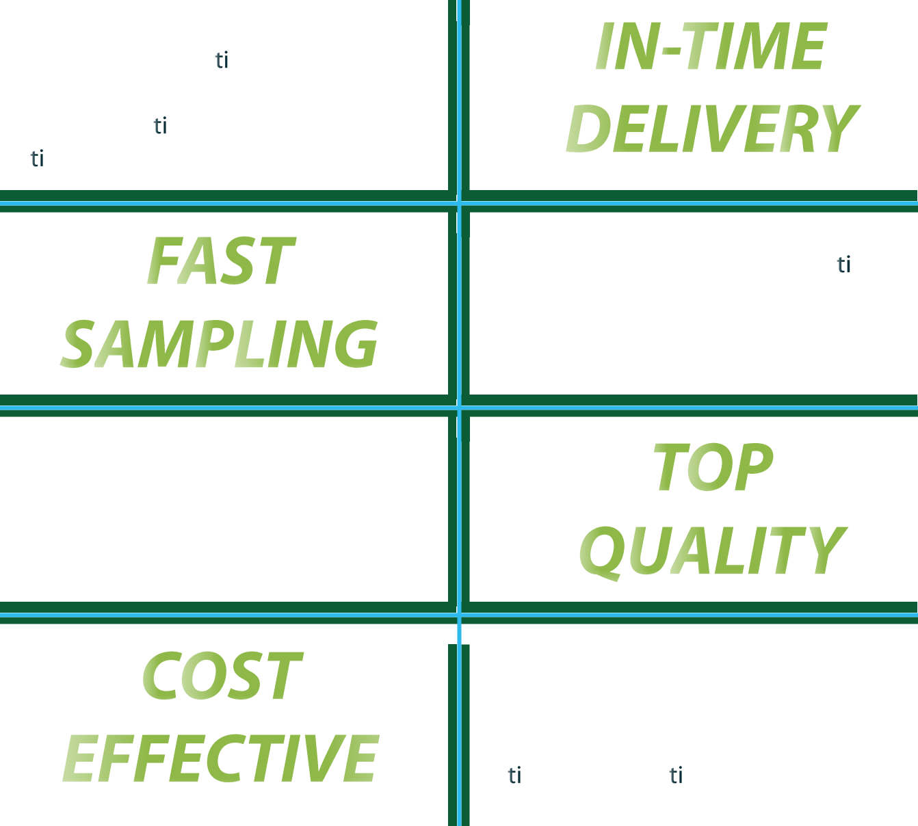
WHY CHOICE US
“ Your money deserves value, and we repay every penny with uncompromising quality,,
We value your urgency, which is why we never allow your lead time to be exceeded. Our strong planning team, alongside our expert production team, ensures the timely dispatch of your goods.
We ensure a perfect and fast sampling process to enhance your product design and development. Our strong supply chain process ensures there are no delays in the development process.
Quality is our top priority, and we never compromise on it. We have established a strong platform equipped with modern technologies to ensure the highest quality products for our customers. Our commitment is to deliver excellence and earn your trust through quality.
Quality is our first and top priority, but not the only one. We also care about your budget, which is why we offer the best support and products within your price range. Our optimized production system helps reduce costs and ensures the best value for your investment.
THANKS FOR BEING HERE

